Slide 1
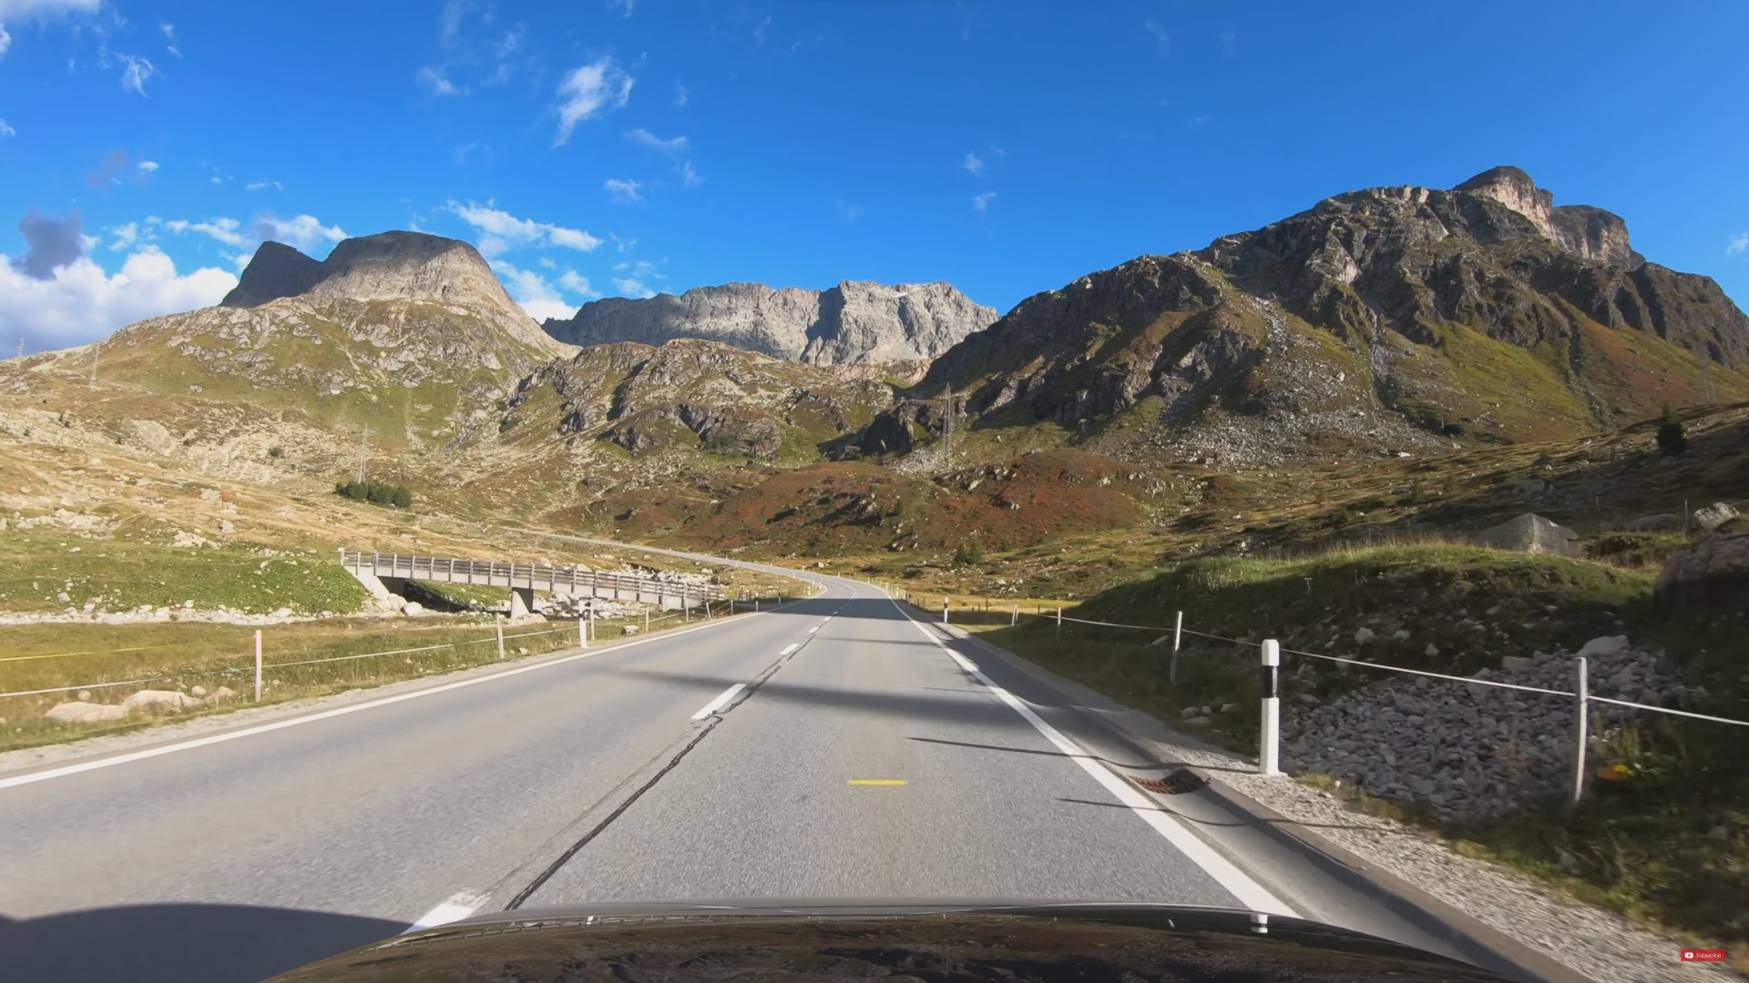

Auto Driving

Slide 2
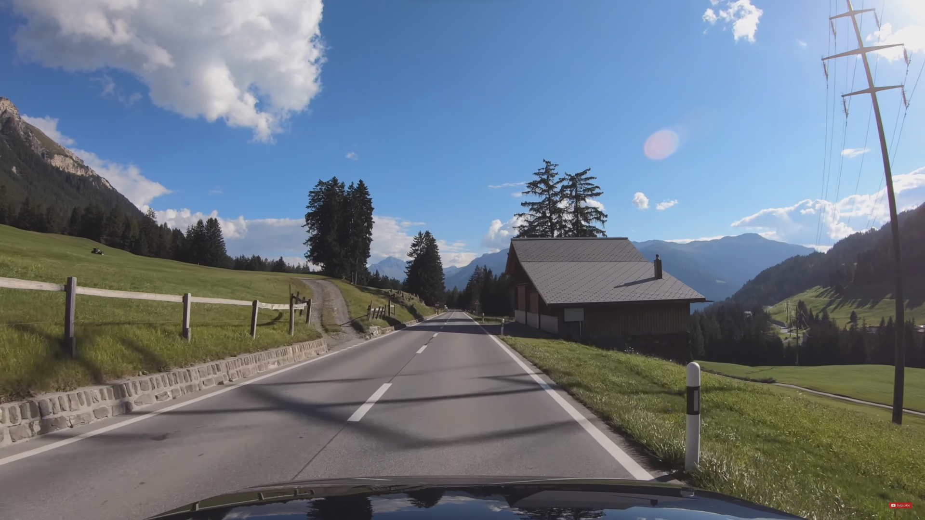
Motivation
Proposed solution
Result
Future extensions and conclusions
INDEX
Notes:
Lucía

Slide 3
Motivation

Slide 4
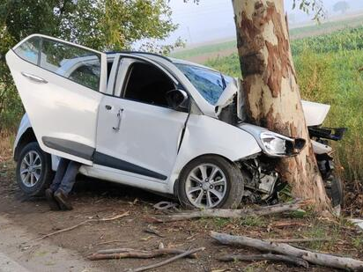
Avoid accidents 921 accidents with deaths 1004 deaths due to accidents STOP CLIMATE CHANGE
Notes:
lucía

Slide 5
Solution

Slide 6
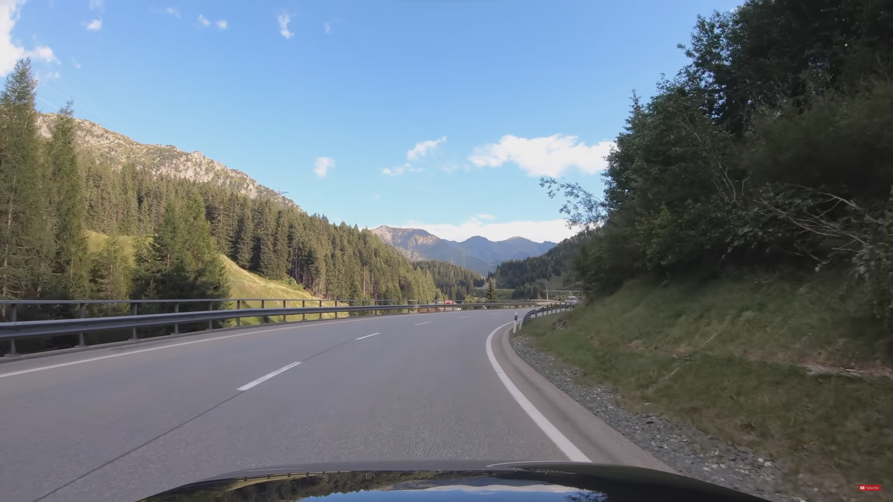
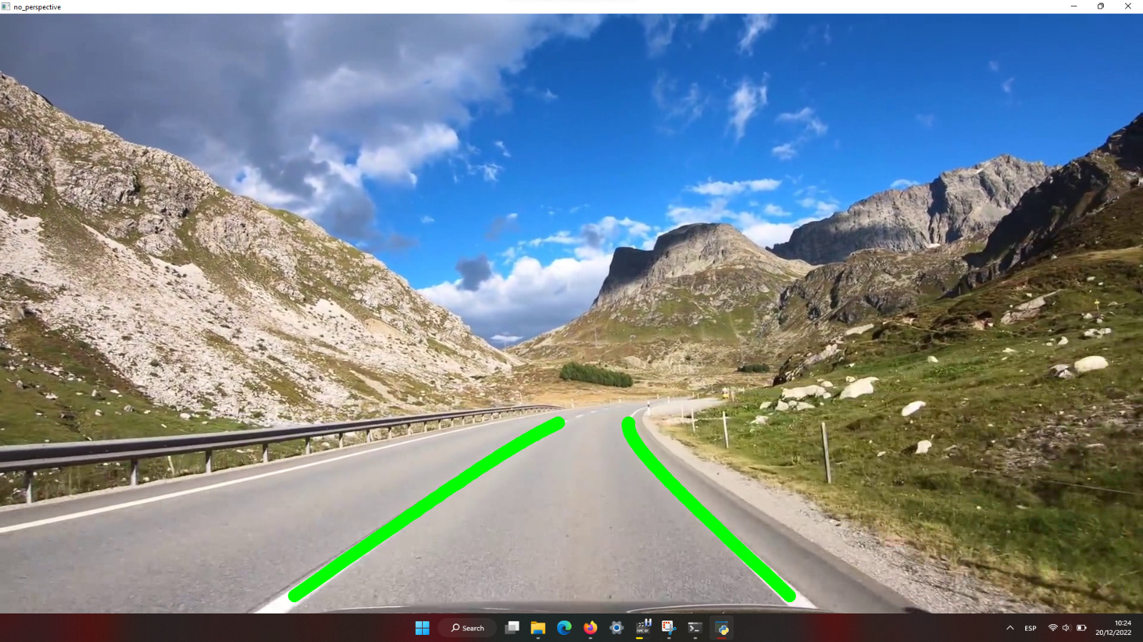
Autonomous car that detects road lanes
Notes:
lucía

Slide 7
Results

Slide 8
Pipeline
Match histograms and binarize
Define side lines
Draw lines
Find peaks
Apply homography
Compute histogram
Sliding window algorithm
Reverse the homography of points
Notes:
Illya

Slide 9
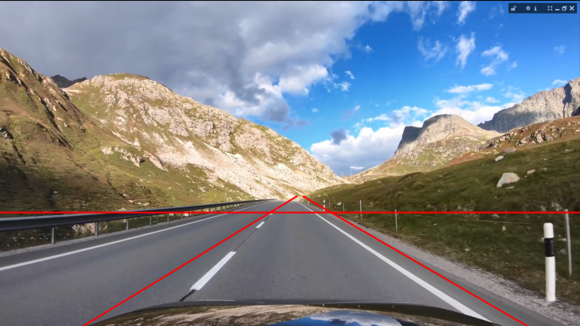
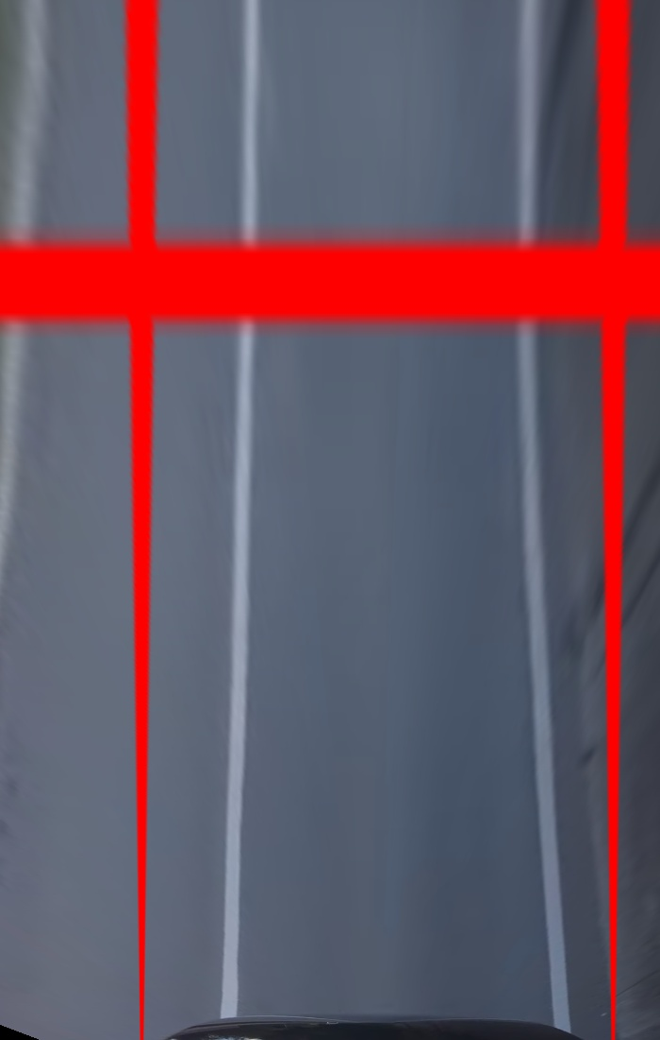
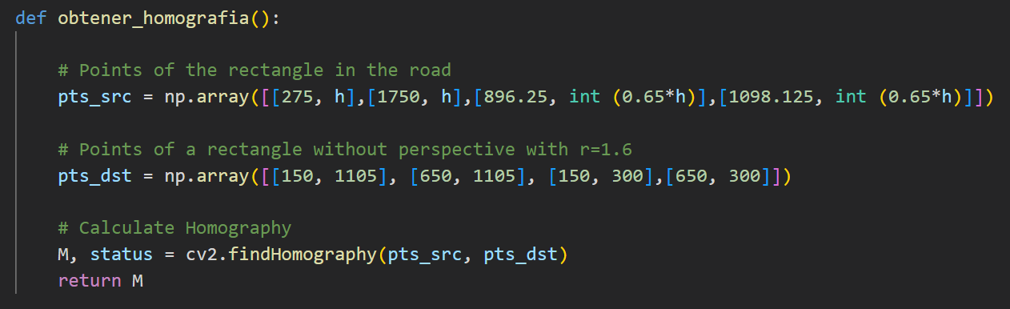
Apply homography
Notes:
Illya

Slide 10
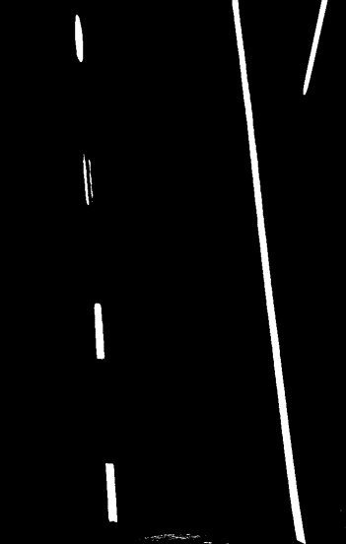

match histograms and binarize
Notes:
Lucia

Slide 11
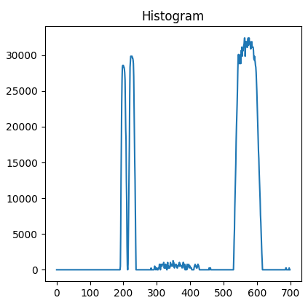
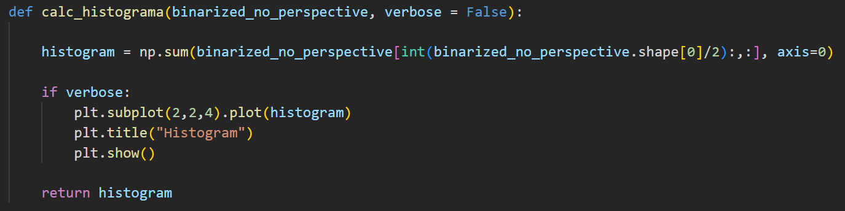
Compute histogram
Notes:
Lucía

Slide 12
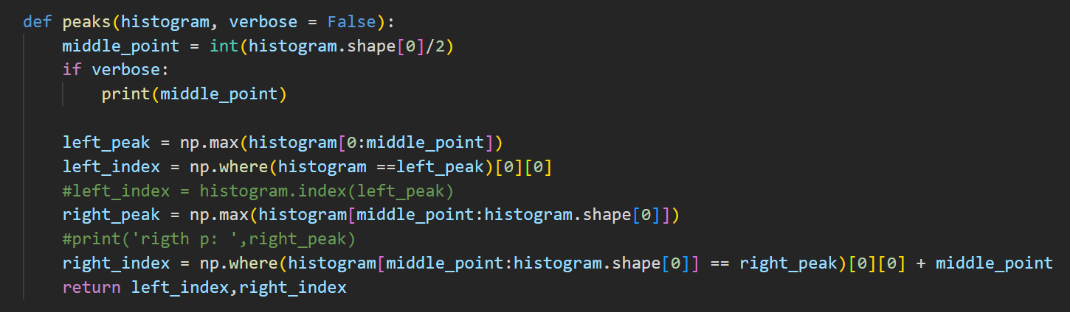
Find peaks
Notes:
Illya

Slide 13
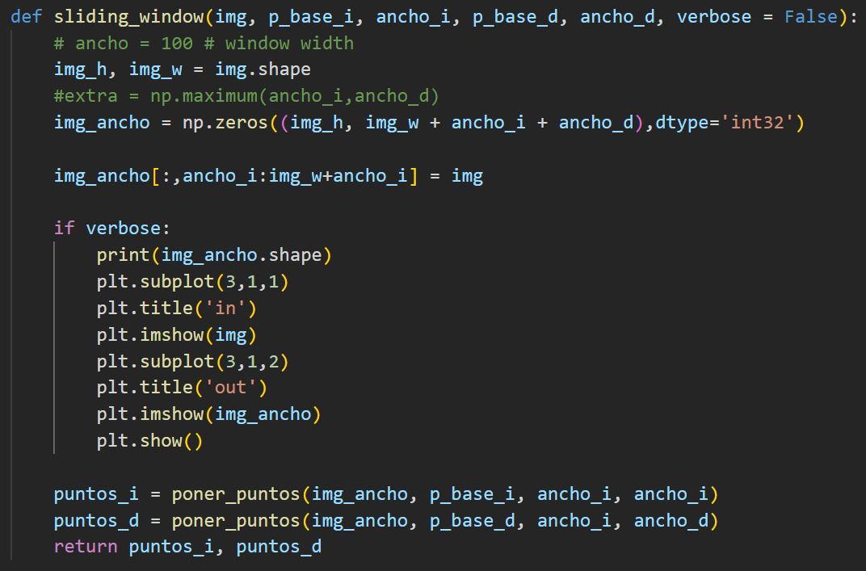
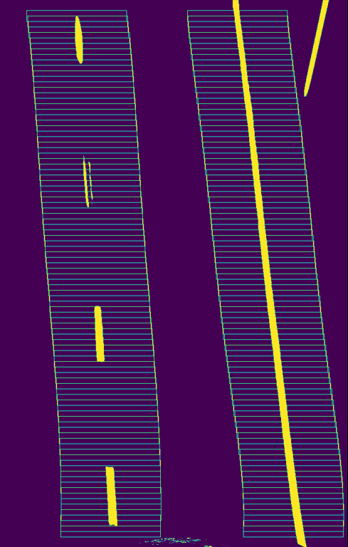
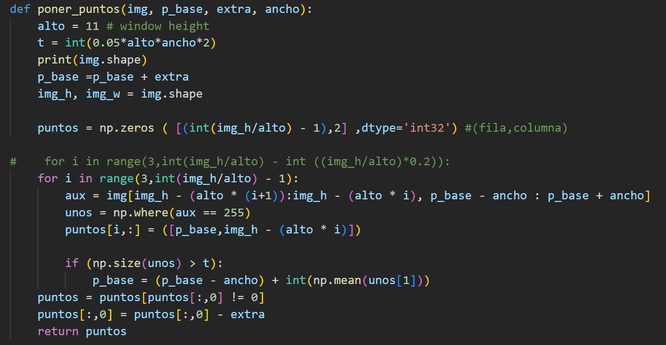
sliding window algorithm
Notes:
Lucía

Slide 14
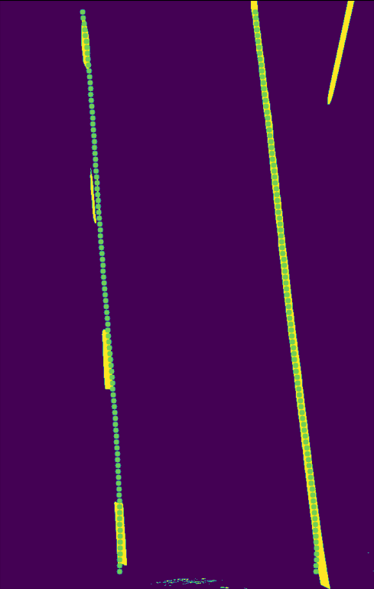
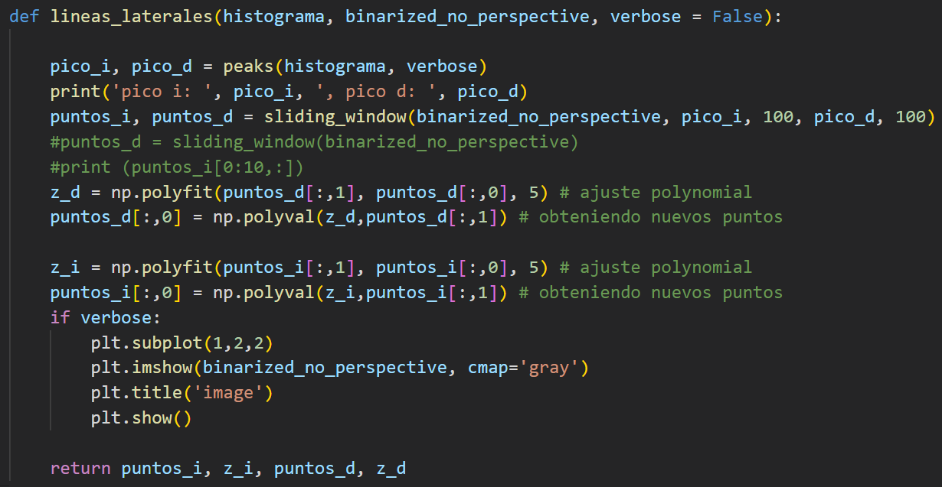
sidelines
Notes:
Illya

Slide 15
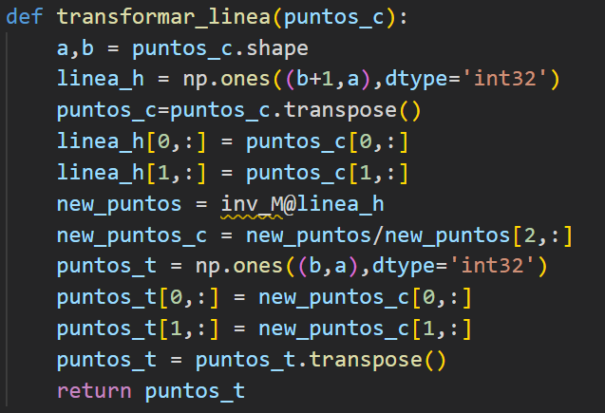
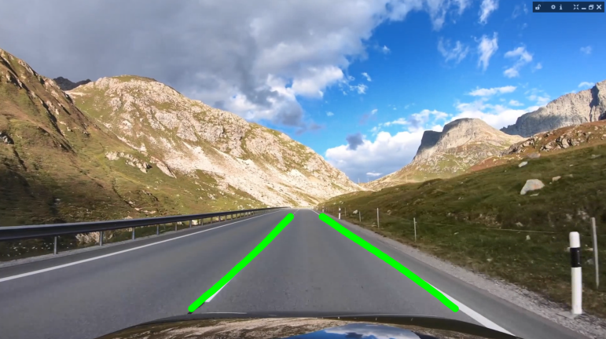
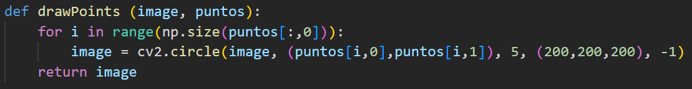
Reverse homography and draw
Notes:
Lucía

Slide 16
Future extensions and conclusion

Slide 17
Post-processing
Provide more information about the result (curvature, …)
Improve binarization techniques
Notes:
Illya

Slide 18
Bibliography

Slide 19
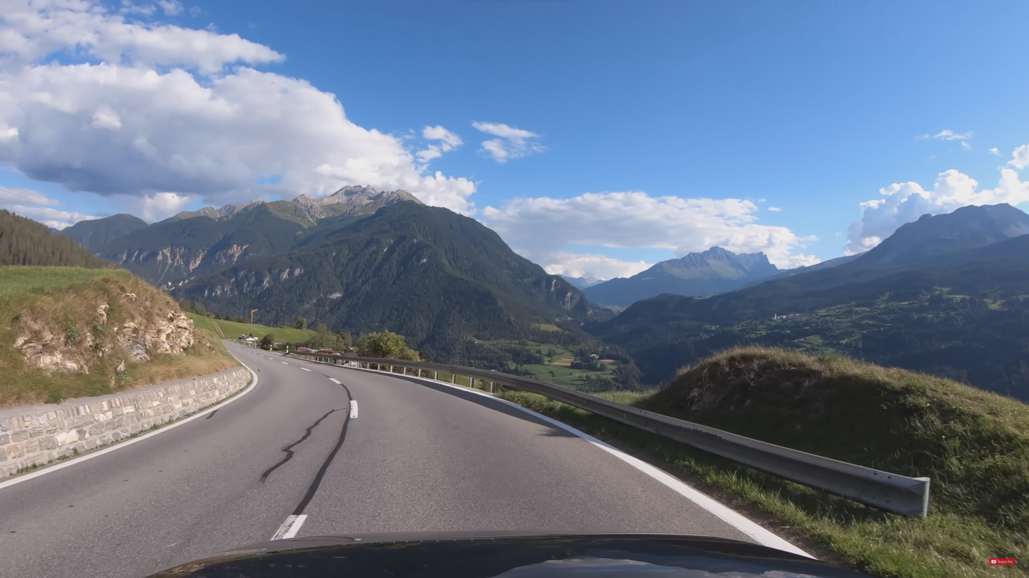
https://www.hindustantimes.com/cities/chandigarh-news/haryana-woman-asi-dies-in-road-accident-101655672197655.html
https://www.lamoncloa.gob.es/serviciosdeprensa/notasprensa/interior/Paginas/2022/070122-balance-siniestralidad-2021.aspx#:~:text=siniestralidad%20vial%202021-,Los%20accidentes%20de%20tr%C3%A1fico%20se%20cobraron%20la,1.004%20personas%20el%20pasado%20a%C3%B1o&text=En%202021%20se%20produjeron%20921,a%C3%B1o%20de%20la%20serie%20hist%C3%B3rica
https://www.dgt.es/menusecundario/dgt-en-cifras/dgt-en-cifras-resultados/dgt-en-cifras-detalle/?id=00834
https://programmerclick.com/article/6637654809/
https://soloelectronicos.com/tag/deteccion-de-curvas/
https://towardsdatascience.com/computer-vision-for-lane-finding-24ea77f25209

Slide 20
demo

